Slide 1




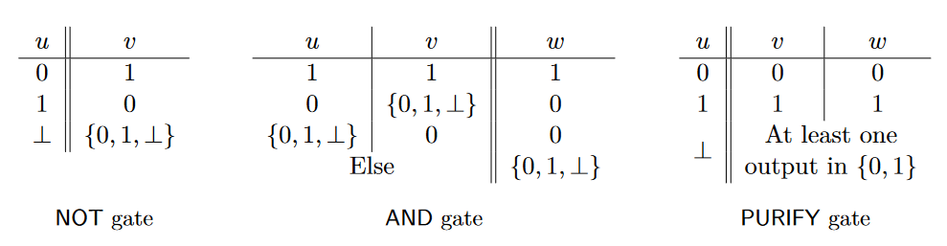




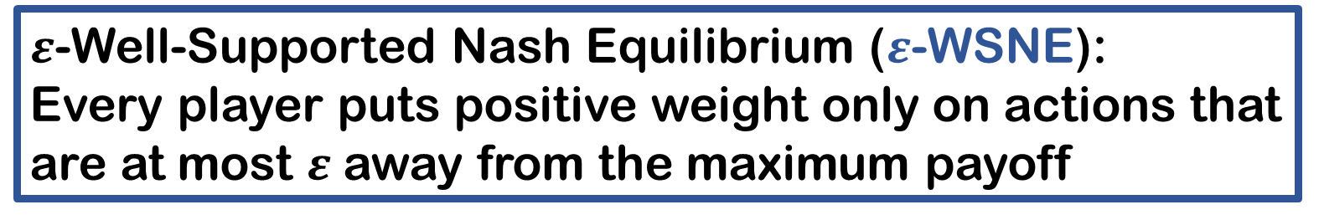
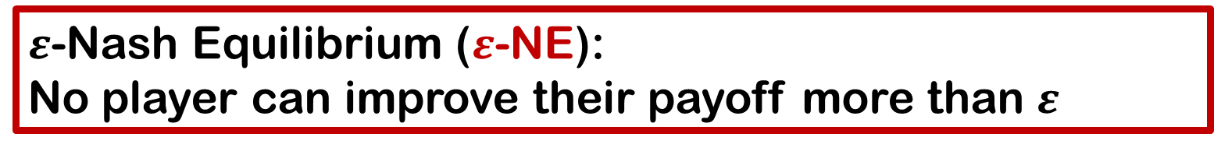
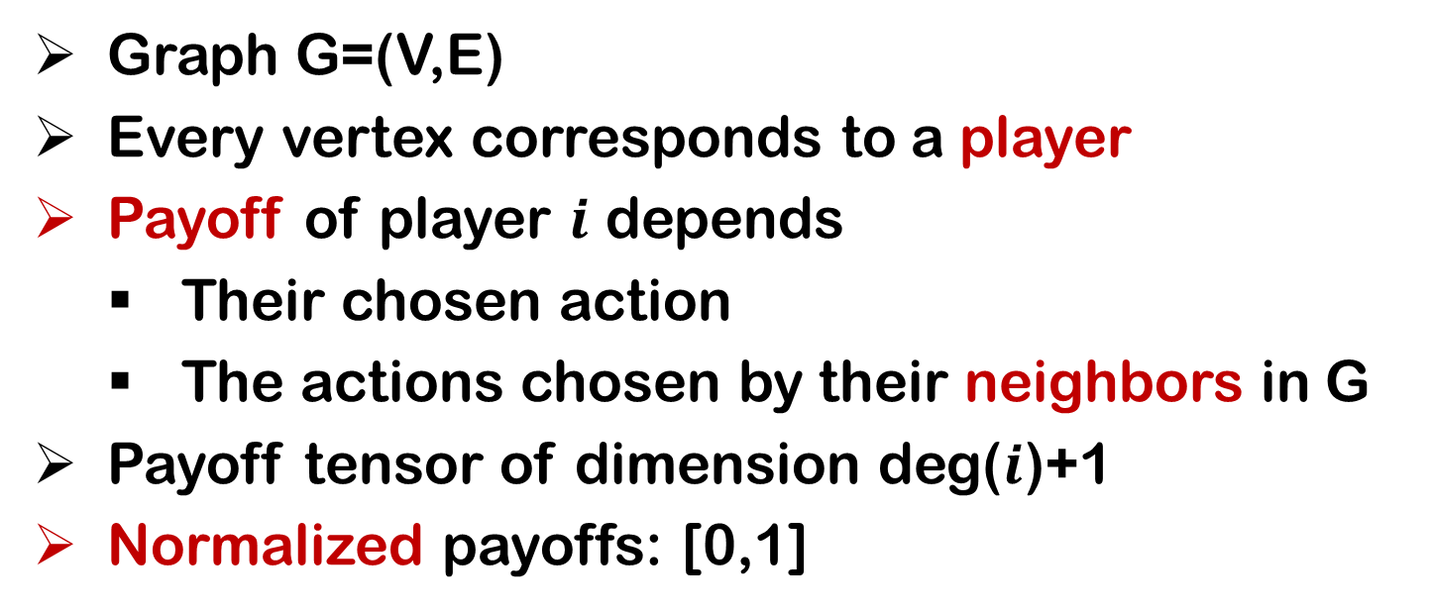
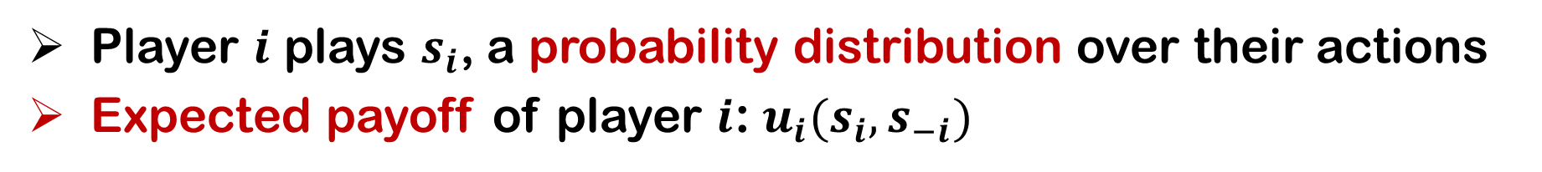
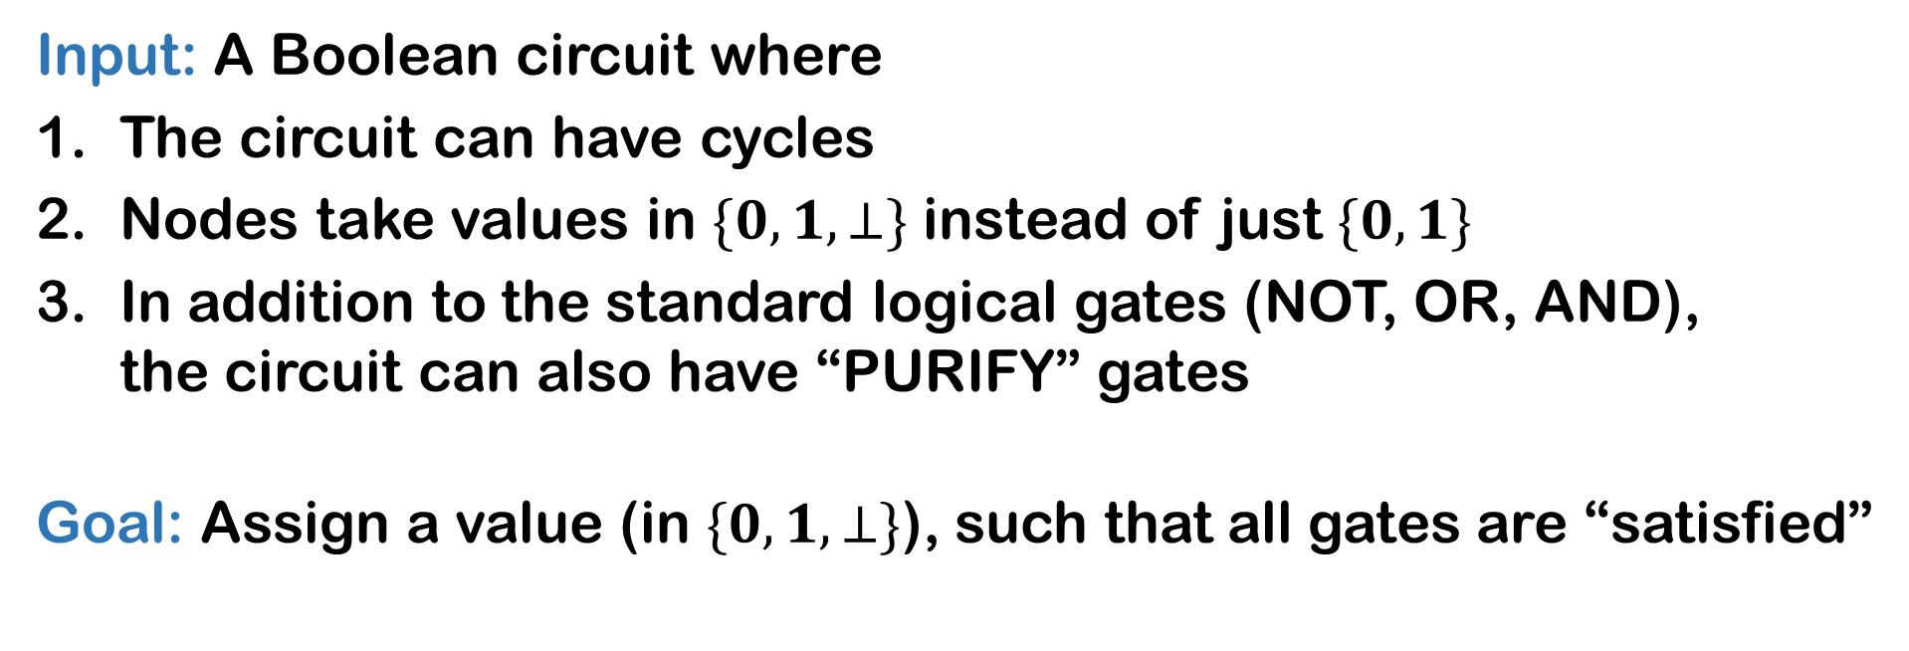
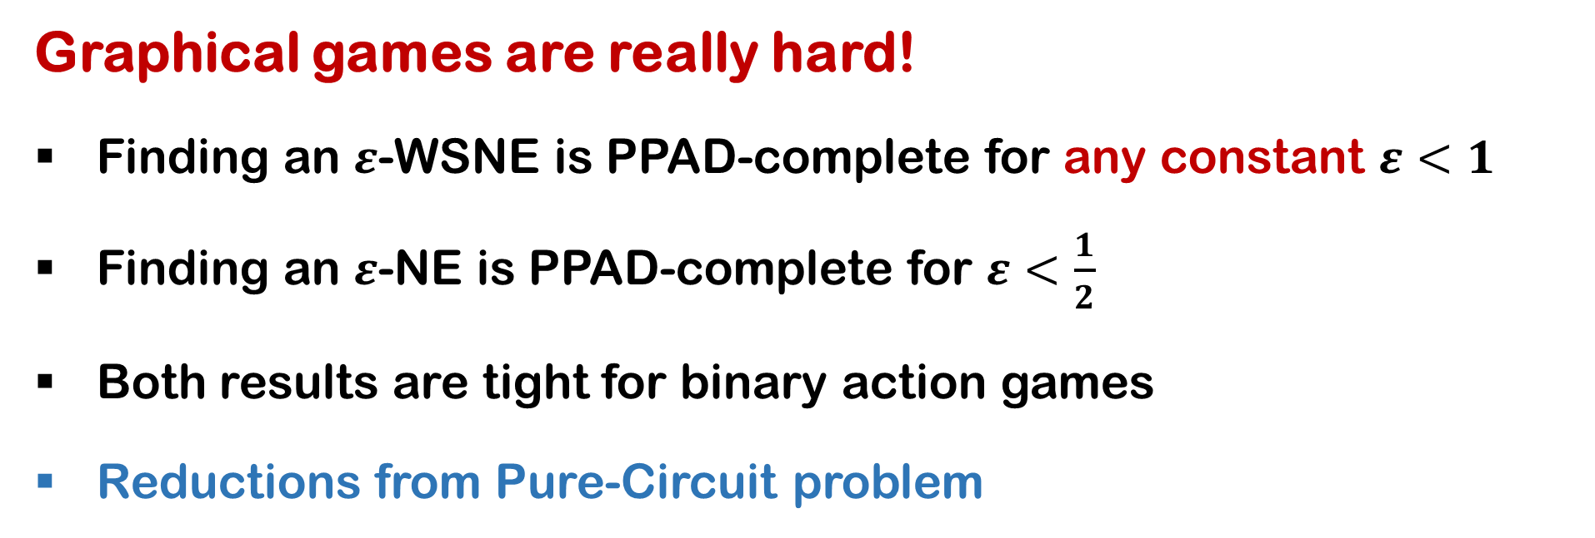
Tight Inapproximability for Graphical Games
Graphical Games
Complexity of Nash Equilibria
The Pure-Circuit Problem
Graph G=(V,E)
Every vertex corresponds to a player
Payoff of player $i$ depends
Their chosen action
The actions chosen by their neighbors in G
Payoff tensor of dimension deg($i$)+1
Normalized payoffs: [0,1]
Input: A Boolean circuit where
The circuit can have cycles
Nodes take values in $\{0,1,⊥\}$ instead of just $\{0,1\}$
In addition to the standard logical gates (NOT, OR, AND), the circuit can also have “PURIFY” gates
Goal: Assign a value (in $\{0,1,⊥\}$), such that all gates are “satisfied”
TFNP
NP Total Search (TFNP) problem!
Total: there is always a solution
NP: it is easy to verify solutions
PPA
PPP
PLS
Can a TFNP problem be NP-hard?
PPAD
P
Not unless co-NP = NP…
Player $i$ plays $s_{i}$, a probability distribution over their actions
Expected payoff of player $i$: ${u_{i}(s}_{i},s_{−i})$
NASH
Nash Equilibria
Our results
Nash Equilibrium (NE): No player can improve their payoff by unilaterally deviating
Graphical games are really hard!
Finding an $ε$-WSNE is PPAD-complete for any constant $ε<1$
Finding an $ε$-NE is PPAD-complete for $ε<\frac{1}{2}$
Both results are tight for binary action games
Reductions from Pure-Circuit problem
Theorem (Nash): Every finite game possesses at least one NE
u
u
v
u
$ε$-Well-Supported Nash Equilibrium ($ε$-WSNE): Every player puts positive weight only on actions that are at most $ε$ away from the maximum payoff
NOT
AND
PURIFY
v
w
v
w
$ε$-Nash Equilibrium ($ε$-NE): No player can improve their payoff more than $ε$
Argyrios
Deligkas
John
Fearnley
Alexandros
Hollender
Themistoklis
Melissourgos

